Slide 1
Data Manipulation with Pandas
PANDAS

Slide 2
Data Manipulation with Pandas (2)
Combining Datasets: Concat and Append
Combining Datasets: Merge and Join
Aggregation and Grouping
Pivot Tables
Visualize data with pandas

Slide 3

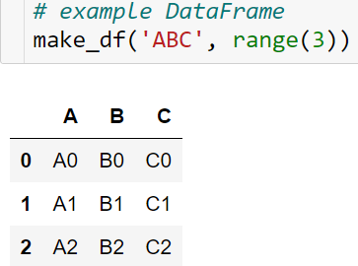
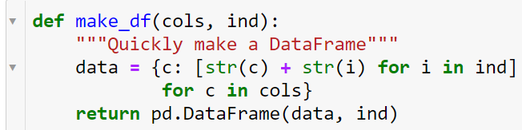
Combining Datasets: Concat and Append
Some of the most interesting studies of data come from combining different data sources. These operations can involve anything from very straightforward concatenation of two different datasets, to more complicated database-style joins and merges that correctly handle any overlaps between the datasets.
Series and DataFrames are built with this type of operation in mind, and Pandas includes functions and methods that make this sort of data wrangling fast and straightforward.

Slide 4
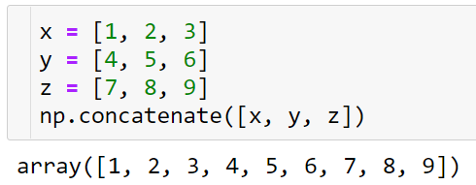
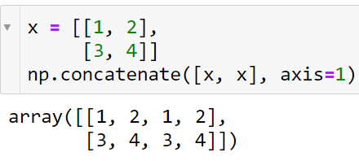
Combining Datasets: Concat and Append
Recall: Concatenation of NumPy Arrays
Concatenation of Series and DataFrame objects is very similar to concatenation of Numpy arrays, which can be done via the np.concatenate function as discussed in The Basics of NumPy Arrays. Recall that with it, you can combine the contents of two or more arrays into a single array:

Slide 5
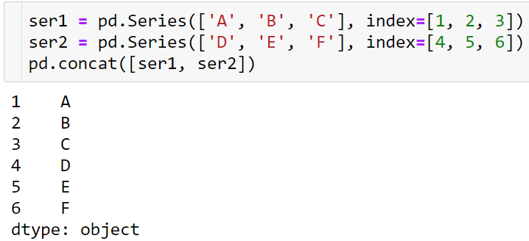
Combining Datasets: Concat and Append
Simple Concatenation with pd.concat
pd.concat(objs, axis=0, join='outer', join_axes=None,
ignore_index=False, keys=None, levels=None,
names=None, verify_integrity=False, copy=True)
pd.concat() can be used for a simple concatenation of Series or DataFrame objects, just as np.concatenate() can be used for simple concatenations of arrays:

Slide 6
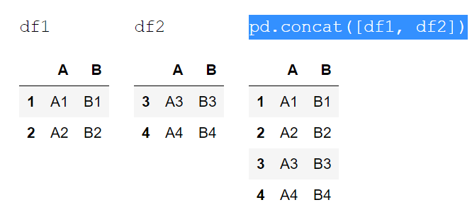

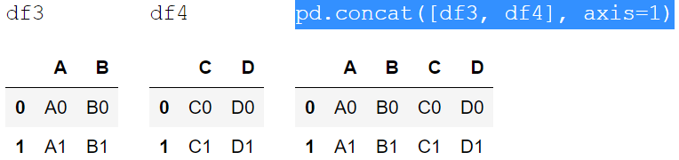
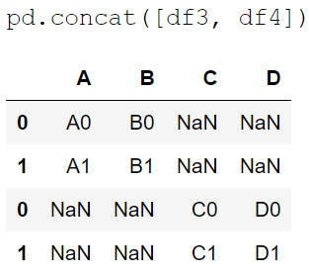

Combining Datasets: Concat and Append
It also works to concatenate higher-dimensional objects, such as DataFrames:
By default, the concatenation takes place row-wise within the DataFrame (i.e., axis=0)
Like np.concatenate, pd.concat allows specification of an axis along which concatenation will take place.

Slide 7
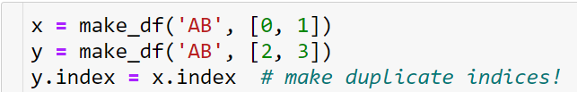
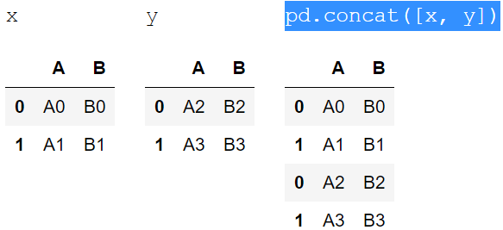
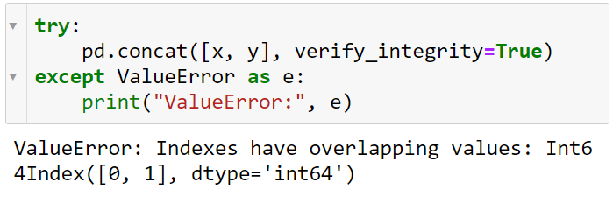
Combining Datasets: Concat and Append
Duplicate indices
Notice the repeated indices in the result. While this is valid within DataFrames, the outcome is often undesirable.
One important difference between np.concatenate and pd.concat is that Pandas concatenation preserves indices, even if the result will have duplicate indices.
Catching the repeats as an error
If you'd like to simply verify that the indices in the result of pd.concat() do not overlap, you can specify the verify_integrity flag. With this set to True, the concatenation will raise an exception if there are duplicate indices.

Slide 8
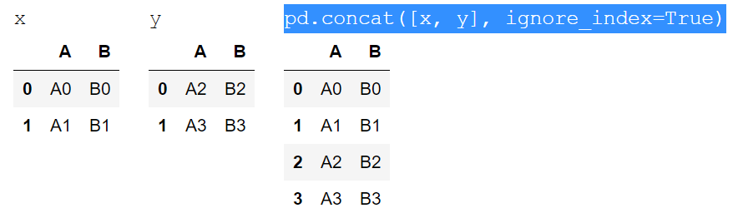
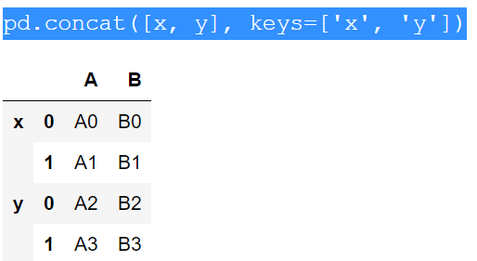
Combining Datasets: Concat and Append
Ignoring the index
Sometimes the index itself does not matter, and you would prefer it to simply be ignored. This option can be specified using the ignore_index flag. With this set to true, the concatenation will create a new integer index for the resulting Series.
Adding MultiIndex keys
Another option is to use the keys option to specify a label for the data sources; the result will be a hierarchically indexed series containing the data:

Slide 9
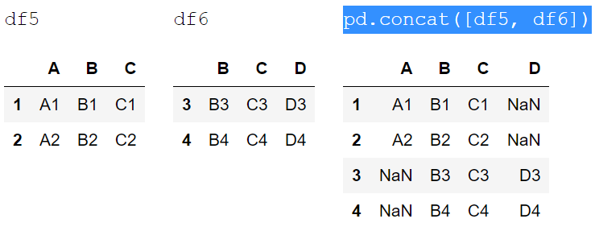

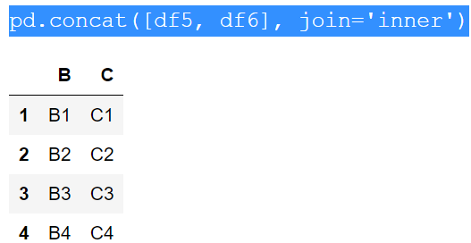
Combining Datasets: Concat and Append
Concatenation with joins
By default, the entries for which no data is available are filled with NA values. To change this, we can specify one of several options for the join and join_axes parameters of the concatenate function. By default, the join is a union of the input columns (join='outer'), but we can change this to an intersection of the columns using join='inner'

Slide 10
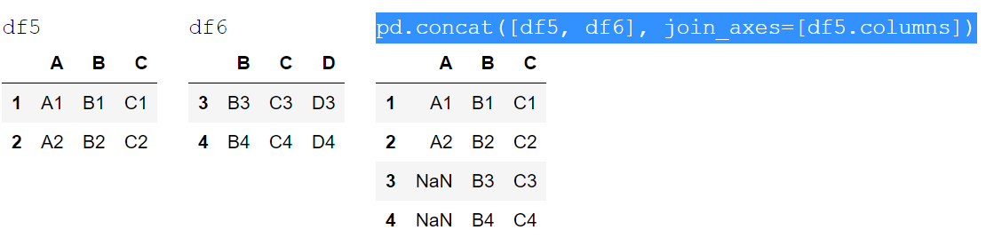
Combining Datasets: Concat and Append
Another option is to directly specify the index of the remaininig colums using the join_axes argument, which takes a list of index objects. Here we'll specify that the returned columns should be the same as those of the first input:

Slide 11
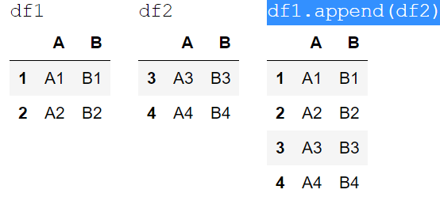
Combining Datasets: Concat and Append
The append() method
Because direct array concatenation is so common, Series and DataFrame objects have an append method that can accomplish the same thing in fewer keystrokes.
For example, rather than calling pd.concat([df1, df2]), you can simply call df1.append(df2):
Keep in mind that unlike the append() and extend() methods of Python lists, the append() method in Pandas does not modify the original object–instead it creates a new object with the combined data.
It also is not a very efficient method, because it involves creation of a new index and data buffer.
Thus, if you plan to do multiple append operations, it is generally better to build a list of DataFrames and pass them all at once to the concat() function.

Slide 12
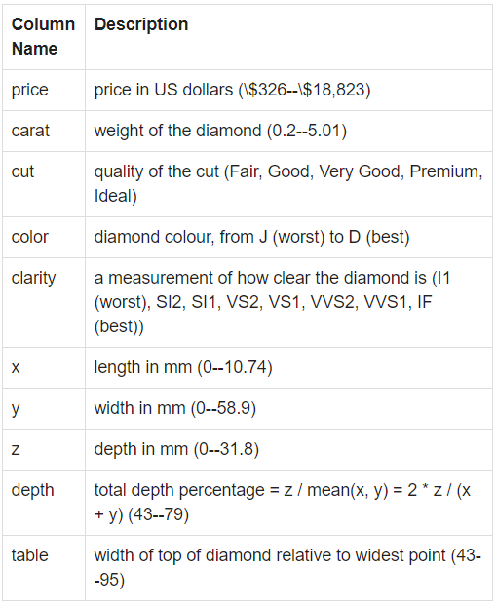
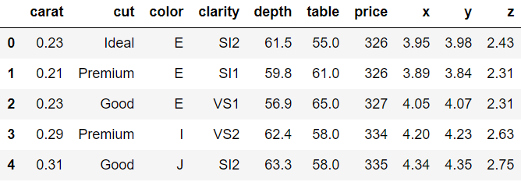
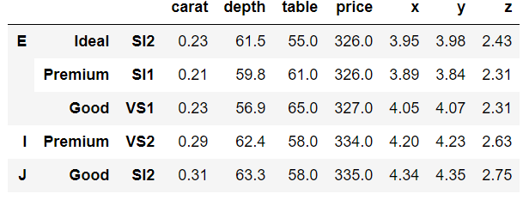
Practice
import pandas as pd
url = ‘https://raw.githubusercontent.com/mwaskom/seaborn-data/master/diamonds.csv’
diamonds = pd.read_csv(url)
data = diamonds.head()
Move

Slide 13
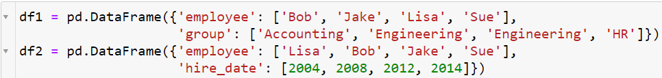
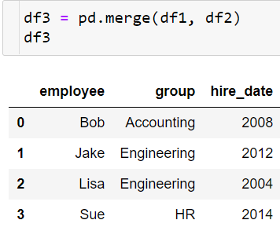
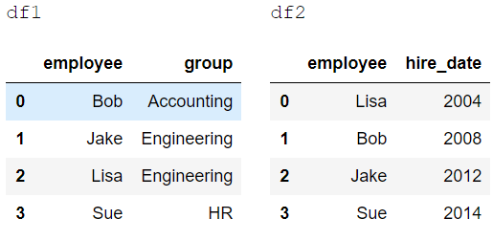
Combining Datasets: Merge and Join
Categories of Joins
The pd.merge() function implements a number of types of joins: the one-to-one, many-to-one, and many-to-many joins.
One-to-one joins
The pd.merge() function recognizes that each DataFrame has an "employee" column, and automatically joins using this column as a key

Slide 14
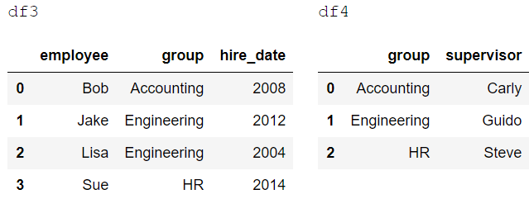
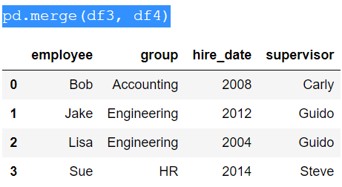
Combining Datasets: Merge and Join
Many-to-one joins
The resulting DataFrame has an aditional column with the "supervisor" information, where the information is repeated in one or more locations as required by the inputs

Slide 15
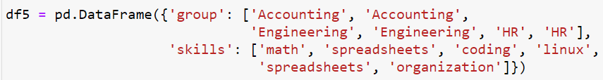
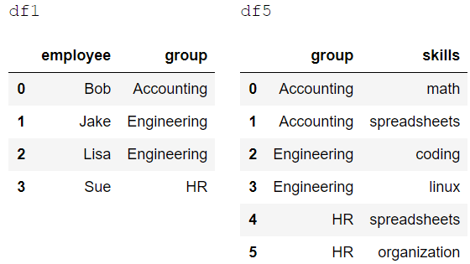
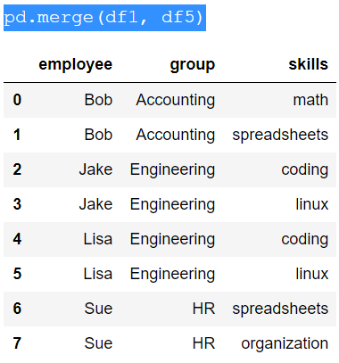
Combining Datasets: Merge and Join
Many-to-many joins

Slide 16
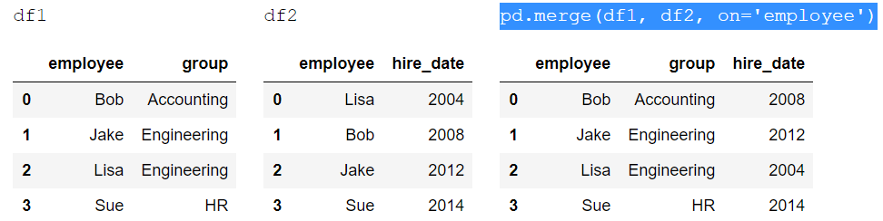
Combining Datasets: Merge and Join
Specification of the Merge Key
We've already seen the default behavior of pd.merge(): it looks for one or more matching column names between the two inputs, and uses this as the key. However, often the column names will not match so nicely, and pd.merge() provides a variety of options for handling this.
The on keyword
This option works only if both the left and right DataFrames have the specified column name.

Slide 17
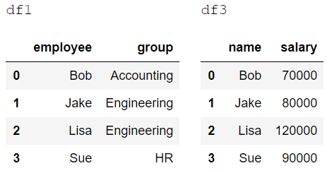
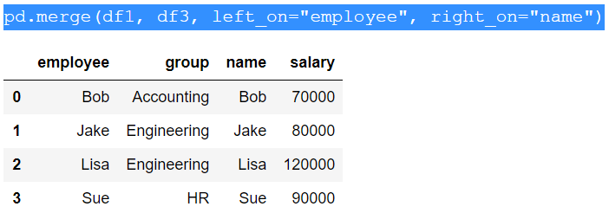

Combining Datasets: Merge and Join
The left_on and right_on keywords
At times you may wish to merge two datasets with different column names. In this case, we can use the left_on and right_on keywords to specify the two column names.
The result has a redundant column that we can drop if desired–for example, by using the drop() method of DataFrames.

Slide 18
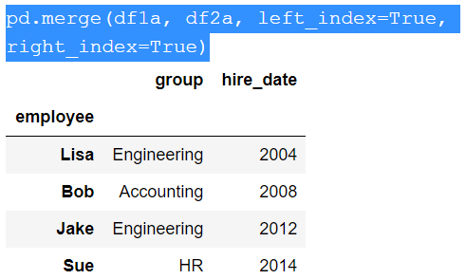

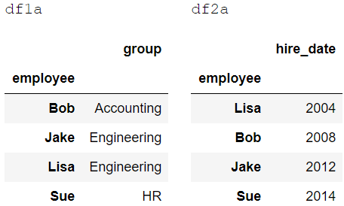
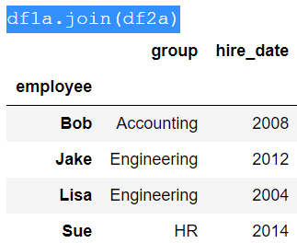
Combining Datasets: Merge and Join
The left_index and right_index keywords
Sometimes, rather than merging on a column, you would instead like to merge on an index.
For convenience, DataFrames implement the join() method, which performs a merge that defaults to joining on indices:

Slide 19
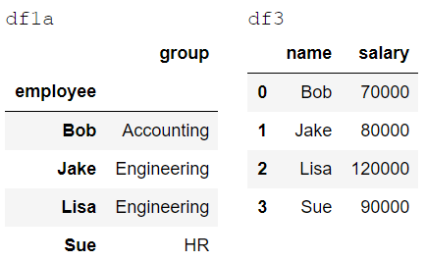
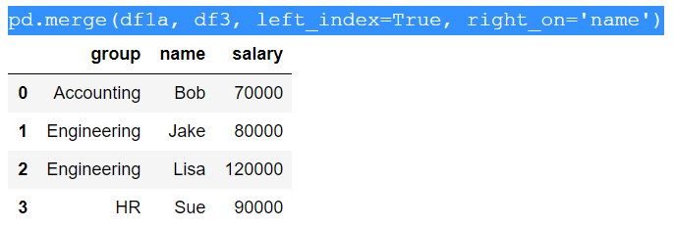
Combining Datasets: Merge and Join
If you'd like to mix indices and columns, you can combine left_index with right_on or left_on with right_index to get the desired behavior:
All of these options also work with multiple indices and/or multiple columns; the interface for this behavior is very intuitive.

Slide 20
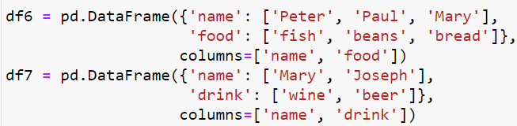
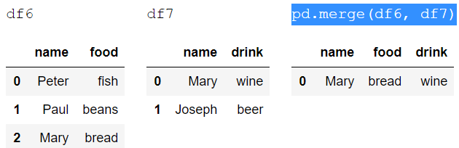
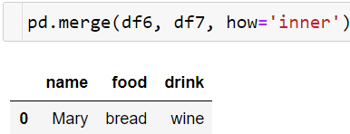
Combining Datasets: Merge and Join
Specifying Set Arithmetic for Joins
In all the preceding examples we have glossed over one important consideration in performing a join: the type of set arithmetic used in the join. This comes up when a value appears in one key column but not the other.
Here we have merged two datasets that have only a single "name" entry in common: Mary. By default, the result contains the intersection of the two sets of inputs; this is what is known as an inner join.

Slide 21
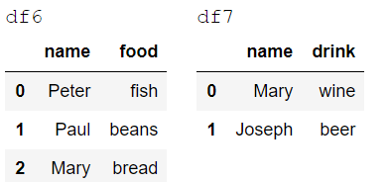
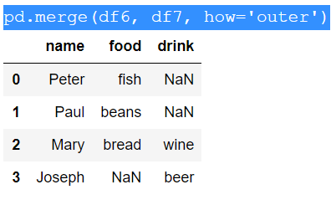
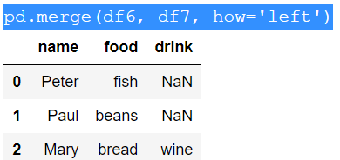
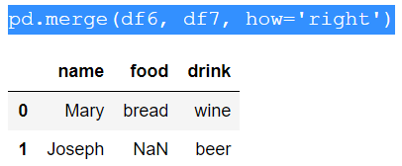
Combining Datasets: Merge and Join
The left join and right join return joins over the left entries and right entries, respectively.

Slide 22
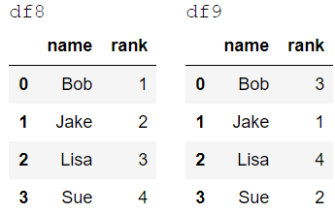
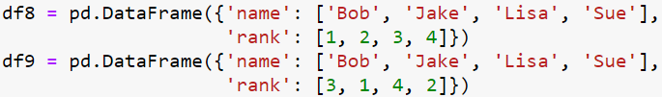
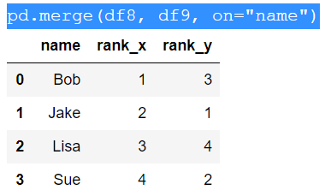
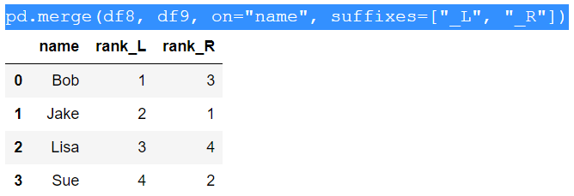
Combining Datasets: Merge and Join
Overlapping Column Names: The suffixes Keyword
Finally, you may end up in a case where your two input DataFrames have conflicting column names.
Because the output would have two conflicting column names, the merge function automatically appends a suffix _x or _y to make the output columns unique.

Slide 23
Practice: US States Data
url1 = 'https://raw.githubusercontent.com/jakevdp/data-USstates/master/state-population.csv'
url2 = 'https://raw.githubusercontent.com/jakevdp/data-USstates/master/state-areas.csv'
url3 = 'https://raw.githubusercontent.com/jakevdp/data-USstates/master/state-abbrevs.csv’
pop = pd.read_csv(url1)
areas = pd.read_csv(url2)
abbrevs = pd.read_csv(url3)
Rank US states and territories by their 2011 population density.

Slide 24
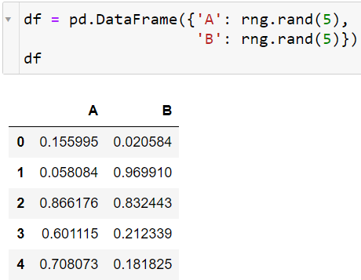
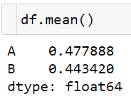
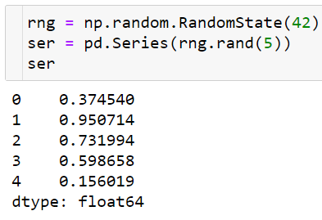



Aggregation and Grouping
For a DataFrame, by default the aggregates return results within each column:
Simple Aggregation in Pandas
As with a one-dimensional NumPy array, for a Pandas Series the aggregates return a single value:
By specifying the axis argument, you can instead aggregate within each row:

Slide 25


Aggregation and Grouping
There is a convenience method describe() that computes several common aggregates for each column and returns the result.
Table summarizes some other built-in Pandas aggregations

Slide 26

Aggregation and Grouping
GroupBy: Split, Apply, Combine
Split, apply, combine
This makes clear what the groupby accomplishes:
The split step involves breaking up and grouping a DataFrame depending on the value of the specified key.
The apply step involves computing some function, usually an aggregate, transformation, or filtering, within the individual groups.
The combine step merges the results of these operations into an output array.

Slide 27




Aggregation and Grouping
Notice that what is returned is not a set of DataFrames, but a DataFrameGroupBy object.
The sum() method is just one possibility here; you can apply virtually any common Pandas or NumPy aggregation function, as well as virtually any valid DataFrame operation.

Slide 28



Aggregation and Grouping
The GroupBy object
The GroupBy object is a very flexible abstraction. In many ways, you can simply treat it as if it's a collection of DataFrames, and it does the difficult things under the hood.
Column indexing
Iteration over groups

Slide 29


Aggregation and Grouping
Dispatch methods

Slide 30


Aggregation and Grouping
Aggregate, filter, transform, apply
Aggregation
We're now familiar with GroupBy aggregations with sum(), median(), and the like, but the aggregate() method allows for even more flexibility.

Slide 31



Aggregation and Grouping
Filtering
A filtering operation allows you to drop data based on the group properties.

Slide 32

Aggregation and Grouping
Transformation
While aggregation must return a reduced version of the data, transformation can return some transformed version of the full data to recombine. For such a transformation, the output is the same shape as the input.

Slide 33



Aggregation and Grouping
The apply() method
The apply() method lets you apply an arbitrary function to the group results. The function should take a DataFrame, and return either a Pandas object (e.g., DataFrame, Series) or a scalar; the combine operation will be tailored to the type of output returned.

Slide 34

Practice
Handling missing data
Using describe() method
Groupby on “method” column and give a simple aggregation...
Groupby on ['method','year’, ‘number’]…

Slide 35

Pivot Tables
Motivating Pivot Tables
This contains a wealth of information on each passenger of that ill-fated voyage, including gender, age, class, fare paid, and much more.

Slide 36



Pivot Tables
Pivot Tables by Hand
To start learning more about this data, we might begin by grouping according to gender, survival status, or some combination thereof.
This immediately gives us some insight: overall, three of every four females on board survived, while only one in five males survived!
This gives us a better idea of how both gender and class affected survival, but the code is starting to look a bit garbled. While each step of this pipeline makes sense in light of the tools we've previously discussed, the long string of code is not particularly easy to read or use.

Slide 37


Pivot Tables
Pivot Table Syntax
Here is the equivalent to the preceding operation using the pivot_table method of DataFrames:
This is eminently more readable than the groupby approach, and produces the same result.
Multi-level pivot tables
Just as in the GroupBy, the grouping in pivot tables can be specified with multiple levels, and via a number of options.

Slide 38


Pivot Tables
We can apply the same strategy when working with the columns as well
???

Slide 39

Pivot Tables
Additional pivot table options
The full call signature of the pivot_table method of DataFrames is as follows:
Two of the options, fill_value and dropna, have to do with missing data and are fairly straightforward.
The aggfunc keyword controls what type of aggregation is applied, which is a mean by default. As in the GroupBy, the aggregation specification can be a string representing one of several common choices (e.g., 'sum', 'mean', 'count', 'min', 'max', etc.) or a function that implements an aggregation (e.g., np.sum(), min(), sum(), etc.).

Slide 40


Pivot Tables
At times it's useful to compute totals along each grouping.
Notice also here that we've omitted the values keyword; when specifying a mapping for aggfunc, this is determined automatically.
Here this automatically gives us information about the class-agnostic survival rate by gender, the gender-agnostic survival rate by class, and the overall survival rate of 38%.

Slide 41

Practice: Birthrate Data
Let's take a look at the freely available data on births in the United States, provided by the Centers for Disease Control (CDC)
url = ‘https://raw.githubusercontent.com/jakevdp/data-CDCbirths/master/births.csv’
births = pd.read_csv(url)
Let's add a decade column, and take a look at male and female births as a function of decade.
Total birth in the quarters at male and female births
…..

Slide 42


Visualize data with pandas
Plot()

Slide 43

Visualize data with pandas
hist()

Slide 44

Visualize data with pandas
Plot.scatter()

Slide 45
Practice
diamonds = pd.read_csv('https://raw.githubusercontent.com/mwaskom/seaborn-data/master/diamonds.csv')

